Slide 1
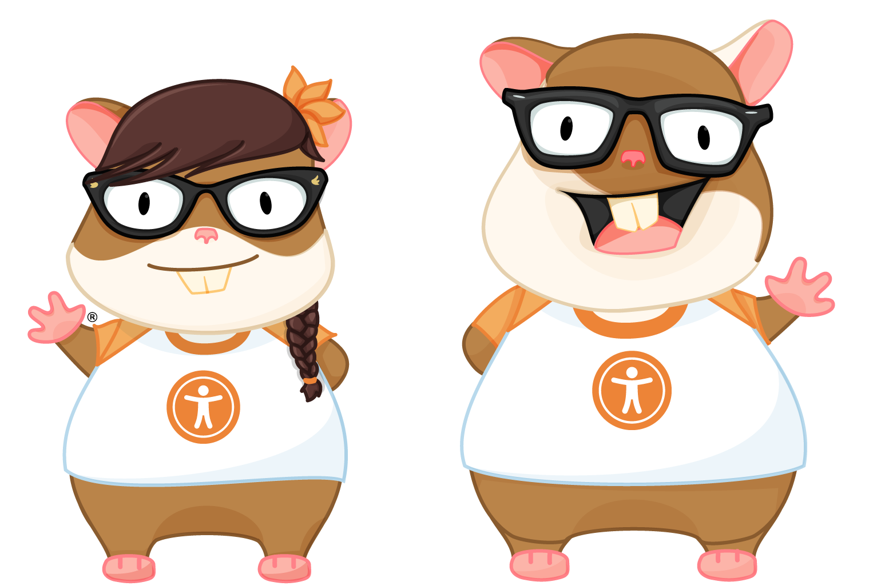

Slide 2
Hi there!!
Notes:
Hi! I’m Melanie. I am a software engineer at JP Morgan Chase, where we use Ember to build ambitious things. My team works on accessible UI components that other teams use to build corporate and investment banking applications.

Slide 3




AMBITIOUs
For all!
Notes:
I wanted to come here today and tell you a story. I wanted to try to make accessibility personal, something everyone here could relate to. So I sat down to write a story.
Except, no one in my family is differently abled. My father isn’t blind; I don’t have a color-blind brother or a grandmother with arthritis. I’ve never had to help my mom navigate a website.
I don’t care about accessibility because someone in my life needs it. I realized the way to make this personal, is to tell you why it’s personal to me.
So – why do I care about accessibility?

Slide 4

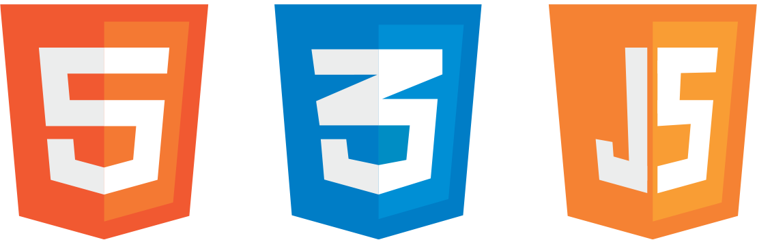
Web standards
Notes:
I care about accessibility because I care about standards. Over the last 22 years, I’ve discovered that the better I get to know web standards, the more clearly I can think about how to architect a solution. I can build new things because I understand the context of how things are already supposed to work.

Slide 5


What Is Accessibility?

Slide 6

Web content accessibility guidelines

Slide 7

WCAG 2.0
A
AA
AAA

Slide 8
Americans with Disabilities Act

Slide 9
ADA

Slide 10
#A11y

Slide 11

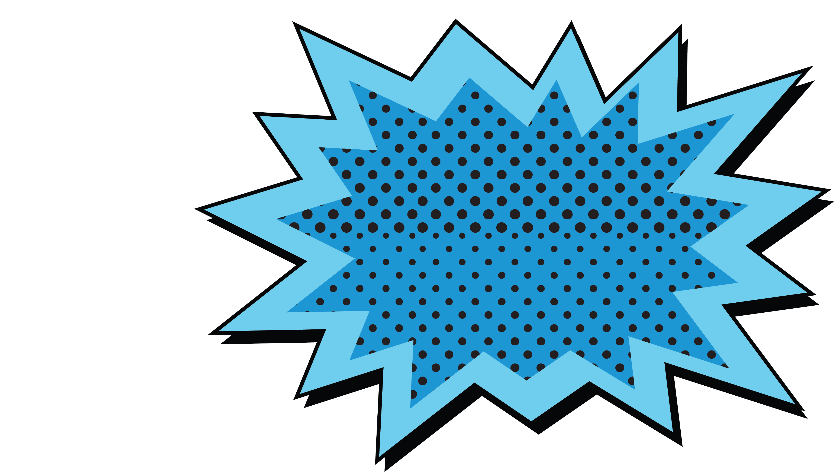
the future
Is now!!

Slide 12

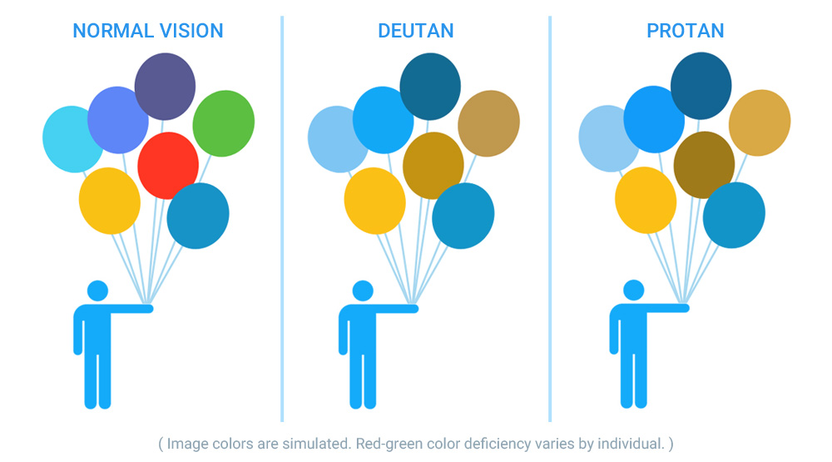
See color!!
Notes:
EnChroma glasses give color-blind people the ability to see color- did you know that there are an estimated 300 million people in the world with a color vision deficiency? Did you also know that many people with color blindness cannot tell that the power connector on a MacBook changes color? Did you know that people who experience color-blindness are often surprised to learn that peanut butter is not green?

Slide 13


Hear!!
(Auditory brain stem implant surgery that gave a three year old boy the ability to hear for the first time.)
Notes:
Doctors at the UNC School of Medicine in Chapel Hill performed the first auditory brain stem implant surgery, which gave a deaf child back his hearing.

Slide 14
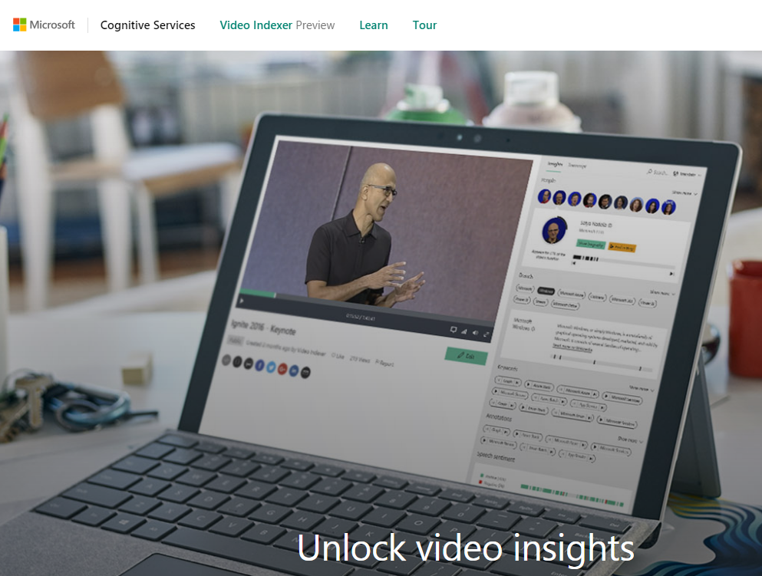
Auto-Generate text
Notes:
Microsoft has developed a cloud service called Video Indexer
It can provide transcriptions, and extract text that appears in video that isn’t spoken
It can translate to different languages
It can analyze the sentiment
Separate background noise and voice activity, providing clearer spoken word
Even adjust the language model used for transcription – making it industry or market specific.

Slide 15
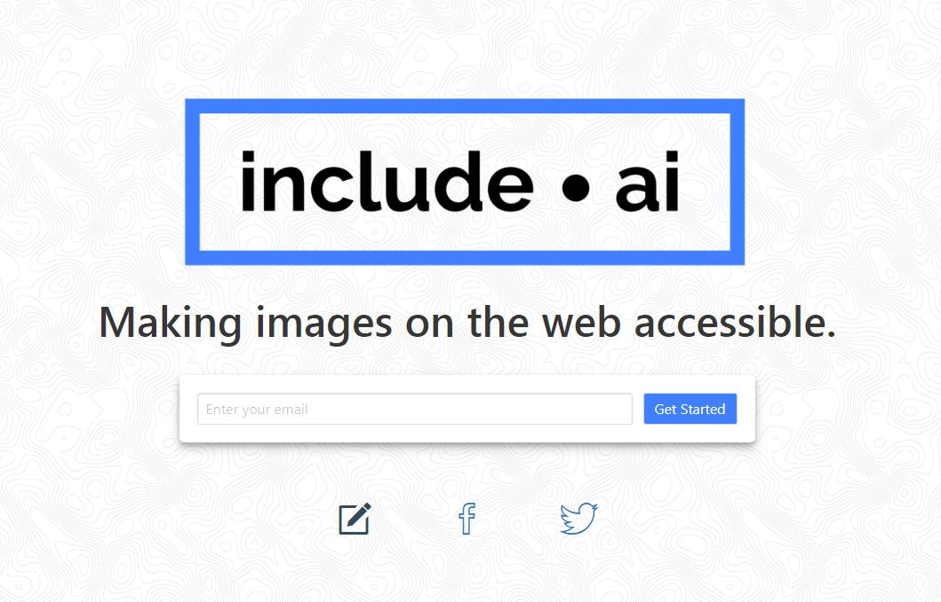
Image descriptions
Notes:
Microsoft has developed a cloud service called Video Indexer, that determines the content of a video, providing captions, extracting keywords, highlighting text and can even determine feelings based on what is being said and the facial expressions of the people in the video.

Slide 16

accessibility
Is emotional

Slide 17

Our users...
I need to check my
bank balance and
pay my bills!

Slide 18
Our users...
I wanted to buy
A present for
My nephew!

Slide 19
Our users...
I wanted to
Subscribe to that
Really awesome
New service!

Slide 20


Our users...
Why don’t they care?

Slide 21

Developers...
My Project
Manager will be
Upset if I don’t
Finish this now!
My team lead
Said to ship it
Now, and we’ll
Fix it later!
Notes:
Accessibility is emotional for developers, too.
we’re under pressure to finish projects that have been promised at an unrealistic timeline
We’re being told to “ship it now and fix it later” and for a lot of us, that became the way things are.

Slide 22
Developers...
I have to
prove That I’m a
Ninjarockstarunicorn!

Slide 23


Slide 24
accessibility
Is hard!

Slide 25





Hard problems!
Route transitions
Modals
aria-* attribute support
Click all the things!
Passwords
Notes:
We will all have things that we think are the hardest to do, but this is my list of “top five hard a11y things that I’d like to see permanently solved in Ember”
Route transitions. We all understand how routing in Ember works- but one of the downsides is that when the route changes, nothing is announced to the screen reader other than a link being clicked. If you are depending only on what the screen reader is telling you, you’d have no way to know that the link did what it was supposed to do. It’s an issue with all SPAs out of the box.
Modals that insert themselves correctly into the DOM and trap focus

Slide 26



Hard problems!
Route
transitions
Notes:
Testing this layout/design. IDK if I like it.

Slide 27
Hard problems!
modals
Notes:
Testing this layout/design. IDK if I like it.

Slide 28
Hard problems!
Attribute support
Notes:
Testing this layout/design. IDK if I like it.

Slide 29
Hard problems!
Click all the things!
Notes:
Testing this layout/design. IDK if I like it.

Slide 30
Hard problems!
Passwords
Notes:
Testing this layout/design. IDK if I like it.

Slide 31


Slide 32
The “Easy” wins!!
Use html5
Link vs. button
Keyboard navigation
Color contrast checks

Slide 33
Developers...
“Tabs vs spaces, fight me.”

Slide 34





Slide 35
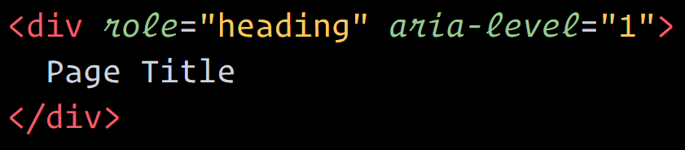

Developers...
“This is fine.”

Slide 36
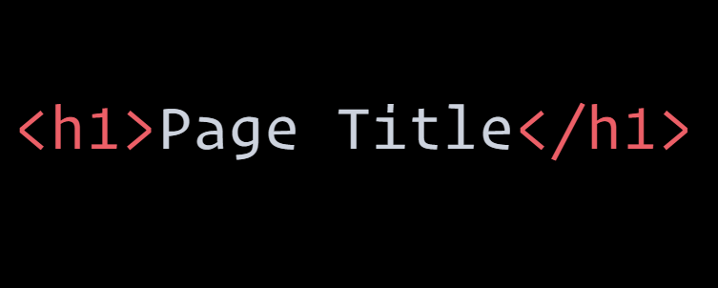

Developers...
Okay,
But…

Slide 37
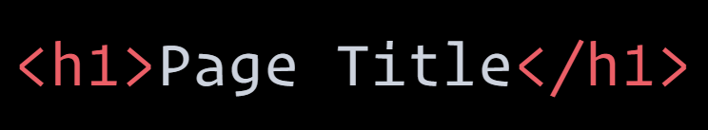
Developers...
Is it tho?
Notes:
So which one is easier?

Slide 38


Slide 39
Ember addons!!
Ember-a11y
A11y-announcer
Ember-a11y-testing
Ember-a11y-landmarks
Ember-component-attributes

Slide 40


be
magnanimous

Slide 41
Magnanimously solve
the same list as hard problems

Slide 42

get
involved

Slide 43


Thank you!!
@melsumner
@melaniersumner

